Slide 1

house price predictions WITH PREDICTIVE analytics
Scott Breitbach, Pushkar Chougule, and Rachel Nelson
Milestone 5 – Final Project Presentation
Bellevue University

Slide 2
Housing Prices
Is this house priced right?
Due to market conditions, it’s hard to know what is considered a “good deal”. By predicting house prices based on factors, we can compare our predicted price to the asking price of a home for sale to help us place a proper bid on a house or sell an existing home.

Slide 3
Overview of Kaggle data set
Available data consists of training (train.csv) and testing (test.csv) data sets
Test data set does not contain target variable and will not be used for modeling
Each data set contains 80 columns and almost 1500 rows (81 with target variable)
Target prediction variable is `SalePrice`
The property's sale price in $USD
About our data set:
Some nominal
Some ordinal (i.e. quality low to high)
29 Numeric variables
Some continuous (e.g. square feet, price)
Some discrete (e.g. number of rooms)
5 DateTime variables
47 Categorical variables

Slide 4
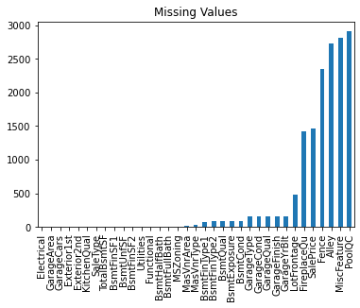

Data Preparation: Imputing Null Values
Most Null values represented the absence of a category (i.e. no garage)
These were changed to 'None' so they could be included
Many Null values for numerical columns were also related to absence of a category (e.g. 'GarageArea')
These were change to a value of '0'
This eliminated the vast majority of Null values
Remaining null values were imputed with the mean or mode
Mean for numerical variables
Mode for categorical variables

Slide 5
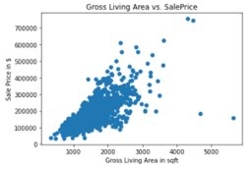
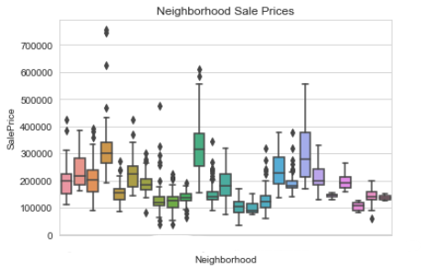
Data analysis: Plots
PLots Reviewed:
scatterplots of numerical data
Boxplots of Categorical/Ordinal data
This helped us look for relationships in the data compared to our target variable, sale price
Notes:
We reviewed boxplots of categorical data to see which ones we could remove based on categorical distributions compared to sales price.

Slide 6
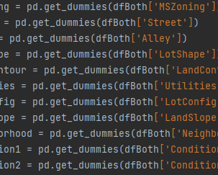
Data Preparation: ordinal & Nominal data transformation
We haD both nominal and ordinal categorical variables and we used scikit-learn's OrdinalEncoder function on the ordinal data and created dummy variables for the nominal items.

Slide 7
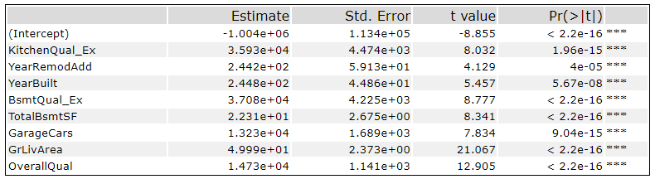
Data Preparation: Feature Selection
We used various techniques to help with feature selection
Correlation: Focused on features with high positive/negative correlation (using Pearson's correlation coefficient)
Linear regression coefficients with strong significant

Slide 8
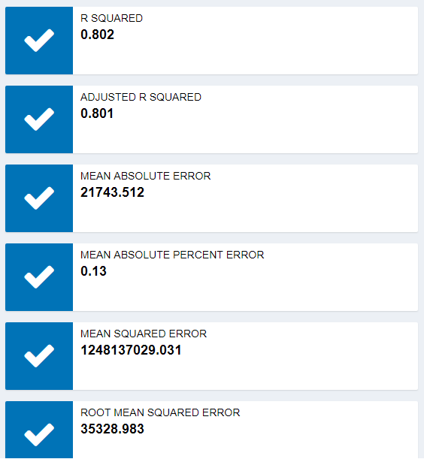
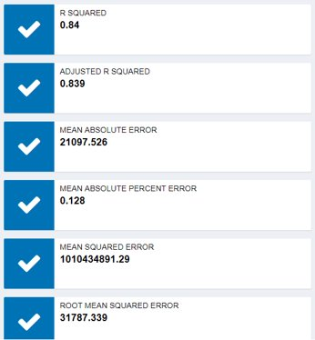
Modeling
Models compared
Linear regression
Decision Tree
We compared both Linear Regression and Decision Tree models to see which performed stronger.
Decision Tree showed stronger results in all categories
pricing is a continuous number as it keeps rising, so using a tree model would be risky, therefore we are proceeding with our linear regression model
SELECTED MODEL
PERFORMANCE
WINNER

Slide 9
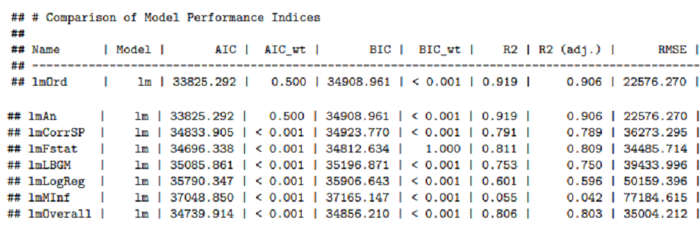
LINEAR ModelS
Linear regression models comparison
Winner: F-stat Linear Model
Lowest AIC and BIC values
Right features selected for efficient performance
Highest Accuracy level

Slide 10
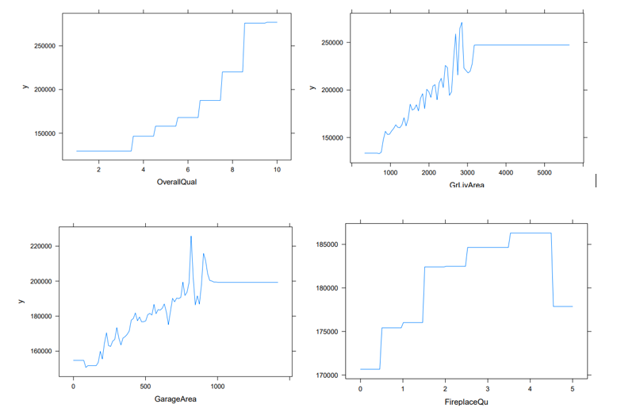
MOST effective FEATURES
4 of the most effective features:
Overall Quality of House
Above Ground Living Area
Garage Area
Additional important features:
Kitchen Quality, Quality of External Materials, Masonry Veneer Type, and Square Footage of a Wood Deck, Number of Full Baths, and Quality of Fireplace

Slide 11
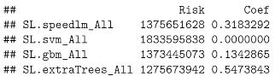
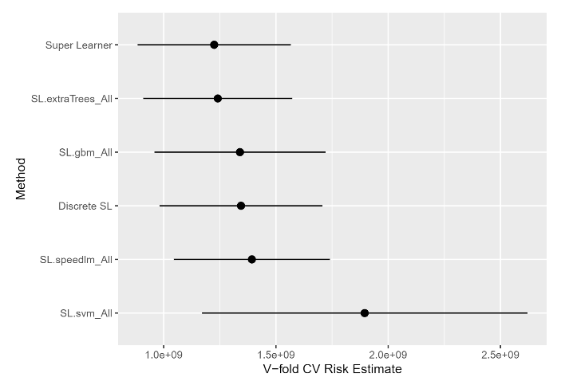
Ensemble Modeling
Machine learning ensembles with `Superlearner()`
Highest Weighted Models
`extraTrees`
Similar to RadomForest
Cuts based on Gini Impurity Index
`speedlm`
Linear Modeling for large data sets
`gbm`
Generalized Boosted Regression

Slide 12
Discussion / Analysis
Issues/Challenges
Feature selection: large number of features
Ordinal Encoding vs. Dummy Variables
Model Selection and Assessment
Project members working in different timezones
Future Work
Continue comparing feature subsets with different models
Evaluate Outliers in the data
Model Deployment

